Slide 1

Service Meshes:
The Production Readiness Checklist for the Rest of Us
Austin Adams & Zach Arnold
Notes:
Why we called it this
Targeting Small, but Innovative teams
We don’t have armies of people to devote to service mesh. But we have needs.
Can have application in big companies but we are targeting smaller

Slide 2


Who is this for?
You are probably:
At KubeCon/CloudNativeCon NA in 2018
Aware of what a Service Mesh is at a high level
Managing a production collection of services (micro or otherwise) that communicate over TCP with each other
Experiencing the pain that comes with running these services at some scale
Needing a solution to your TCP based problems and don’t have time for a complete rework of your application’s architecture
In a small to mid-size business

Slide 3
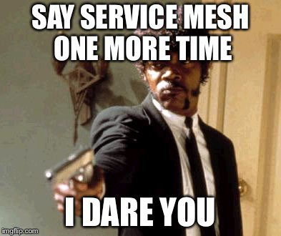
Who is this probably not for?
You are probably not:
Able to dedicate an army of engineers to solving this problem specifically for your business
Currently holding a PhD in Computer Science in the specific field of networking
Already running a service mesh in production

Slide 4


Slide 5

Who/What is Ygrene?
Financial Services Sector
Privately Held, Publicly Good
PACE = Property Assessed Clean Energy
Ygrene = The word “Energy” spelled backwards
Our mission is to make sure that Earth is still a thing in the future.
HIRING IN SEATTLE, FLEXIBLE, REMOTE, WEWORK…
Notes:
Specialized financing using the equity in a building to provide clean energy upgrades.
Over a billion in financing in 6 or so years, operating Kubernetes and Service mesh in production
8 FTE, every second of downtime is $144 lost.

Slide 6
Service Meshes Distilled
With every “Mesh” worth using you’ll get:
TCP proxying
(HTTP1,1.1,2.0,gRPC…)
Traffic Flow Control:
DNS (or Service Discovery)
Load Balancing
Timeouts/Retries/Fault Injection/Circuit Breaking
Routing
Security
mTLS
Auth-n/Auth-z
Observability
Metrics
Distributed Tracing
SORRY NO MEME
Notes:
Not every mesh offers security features.

Slide 7
The Landscape...more or less
Linkerd 1 and 2 (CNCF project formerly Conduit)
Istio (IBM + Google) with a proxy:
Envoy (CNCF Proxy Project)
Nginx
Aspen Mesh (Managed Istio)
AWS App Mesh
Azure Service Fabric Mesh
GKE Managed Istio (Is this a thing yet?)
Nginx+…. Seriously you can pay for Nginx

Slide 8
The Roadmap to Production
Assess
Select + Commit
Implement
Release

Slide 9
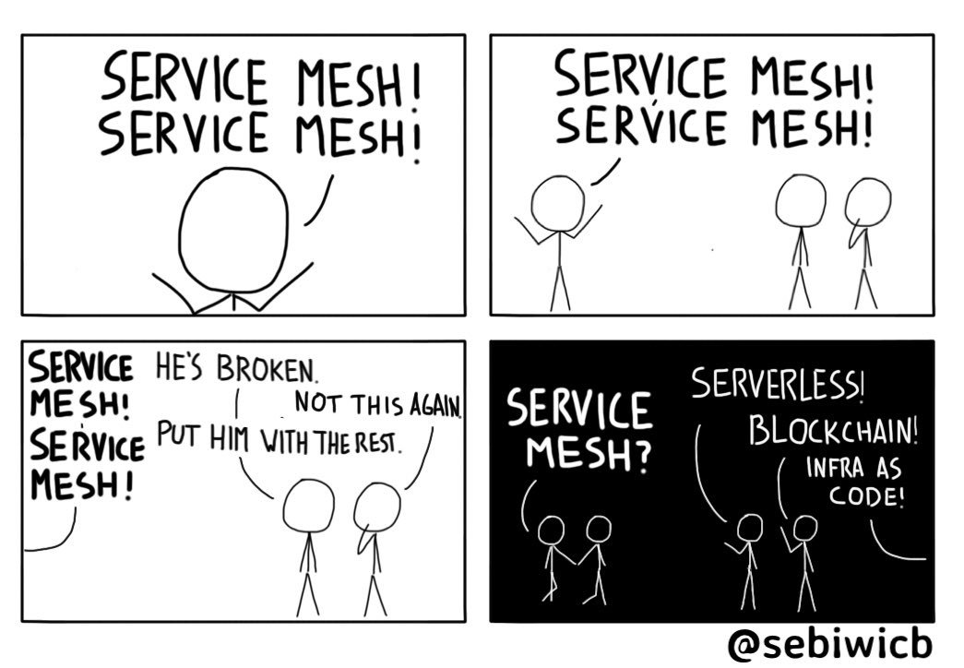
Assess
Do we need a service mesh?, What problem does it solve?
Its okay if that’s a no!
Questions to Ask yourself / POC
Can our team handle the added complexity ?
Can your application handle a service mesh ?
Notes:
Zach will talk about application

Slide 10
Assess
Use Cases
Encryption between microservices without the cert management.
End user JWT authentication (Istio)
Service to service Authentication/Authorization
Tracing/Instrumenting your applications.
Intelligent routing, route by cookie, device, region, canary deployments, api version routing. Mirroring!!, Fault Injection!!
Notes:
You can do all this with other tools, but now you have one tool!
Common problems: Cert management, tcp connection reliability, retry of connection, routing,
Magage: Onboarding, dev prod parity, istio locally

Slide 11
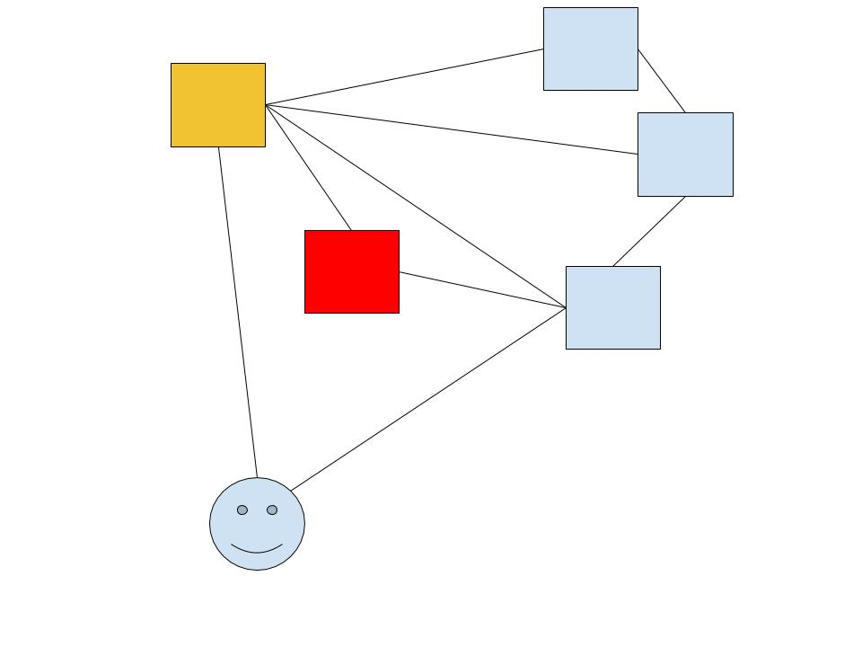
Assess - Our Use Case
Traffic needed to be encrypted, everywhere
Traffic needed to be restricted.
JWT was being validated all the time.
Service to service permissions can be static.
We don’t want to refactor tons of code.
Notes:
Encrypted even from the load balancer to the istio/k8s controlplane
We needed to seperate services that should not talk to each other. Network policies in istio let us focus on our network in one place.

Slide 12
Assess
Feature Mapping
List our projects
List our features
Including the Open Source Test
Add Weights!
Add a number for every feature
Try out the top contenders
Sum each project
Notes:
Your choice of kubernetes installation will impact what service mesh, what feature of your service mesh you can use.

Slide 13
Select + Commit
Before Deciding, consider!
The open source Litmus Test for choosing open-source Technology:
How long has it existed?
How popular is it in terms of contribution/usage?
How well sponsored is it and by whom?
How recently has it changed?
Our general rule is to use a managed service where possible...it lets us concentrate on Ygrene stuff
But we couldn’t (EKS) so we went open source.
Notes:
We evaluated Linkerd2, but nope.

Slide 14
Select + Commit
Our Advice!
Linkerd 2 is simple, easy to install and will get you simple routing, metrics. Use it if you want to get a service mesh going quick.
Istio for literally anything else if you depend on Kubernetes.
Dont ignore Linkerd 1, especially if you have non Kubernetes services.
Notes:
We evaluated Linkerd2, but nope.

Slide 15

ISTIO!!!!!!!!

Slide 16
After talking to you this week...
I changed this portion of the talk
We will focus on a few key areas
Shoehorning Istio (the Envoy sidecar) into your app/Engineer buy-in
The bits and pieces of Istio that don’t work well in EKS yet
How we got it into prod (for our use case, #security)

Slide 17
Implement...not just a demo app
We did the opposite of what the textbook says for a good reason
Our first service in the mesh was the hardest to do and it handles almost 100% of our Ingress, which means we configured Ingress too!
It also has the most other peripherals (3rd party svcs, RDS, Redis...)
This portion of our app is the edge case factory...
The rest of our services inherit from a common base, so updating was a simple as pushing an upstream change and rolling out deploy plans
Dev buy in was simple, since it interrupted almost no one’s workflow

Slide 18
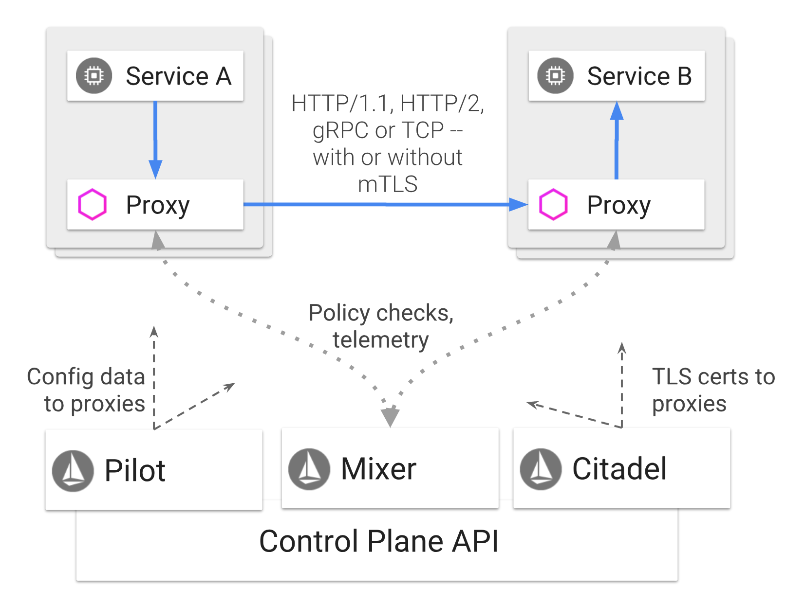
Implement...a suggested strategy
If you can...use Helm
And turn off stuff for EKS
Using your selected features,
focus on the components you need
For us, that was Citadel (mTLS)
We highly recommend working on instrumenting metrics early, it will save you diagnosing problems in the long run

Slide 19
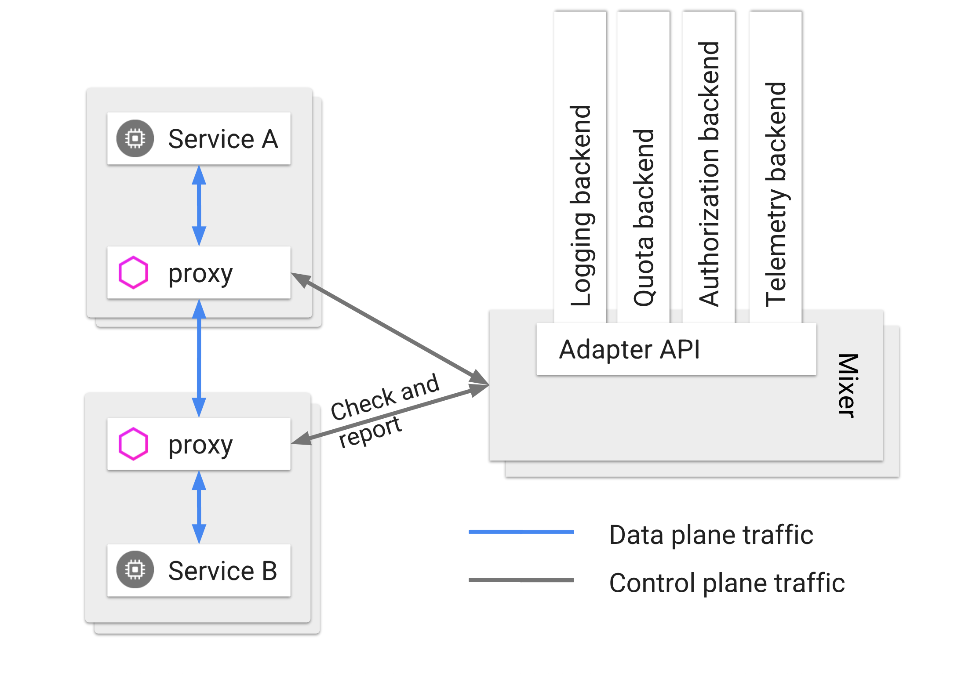
Implement...a suggested strategy
Prometheus (our own)
Fluentd (our own)
Grafana (our own)
Jaeger (SUPER USEFUL FOR DEBUGGING)

Slide 20
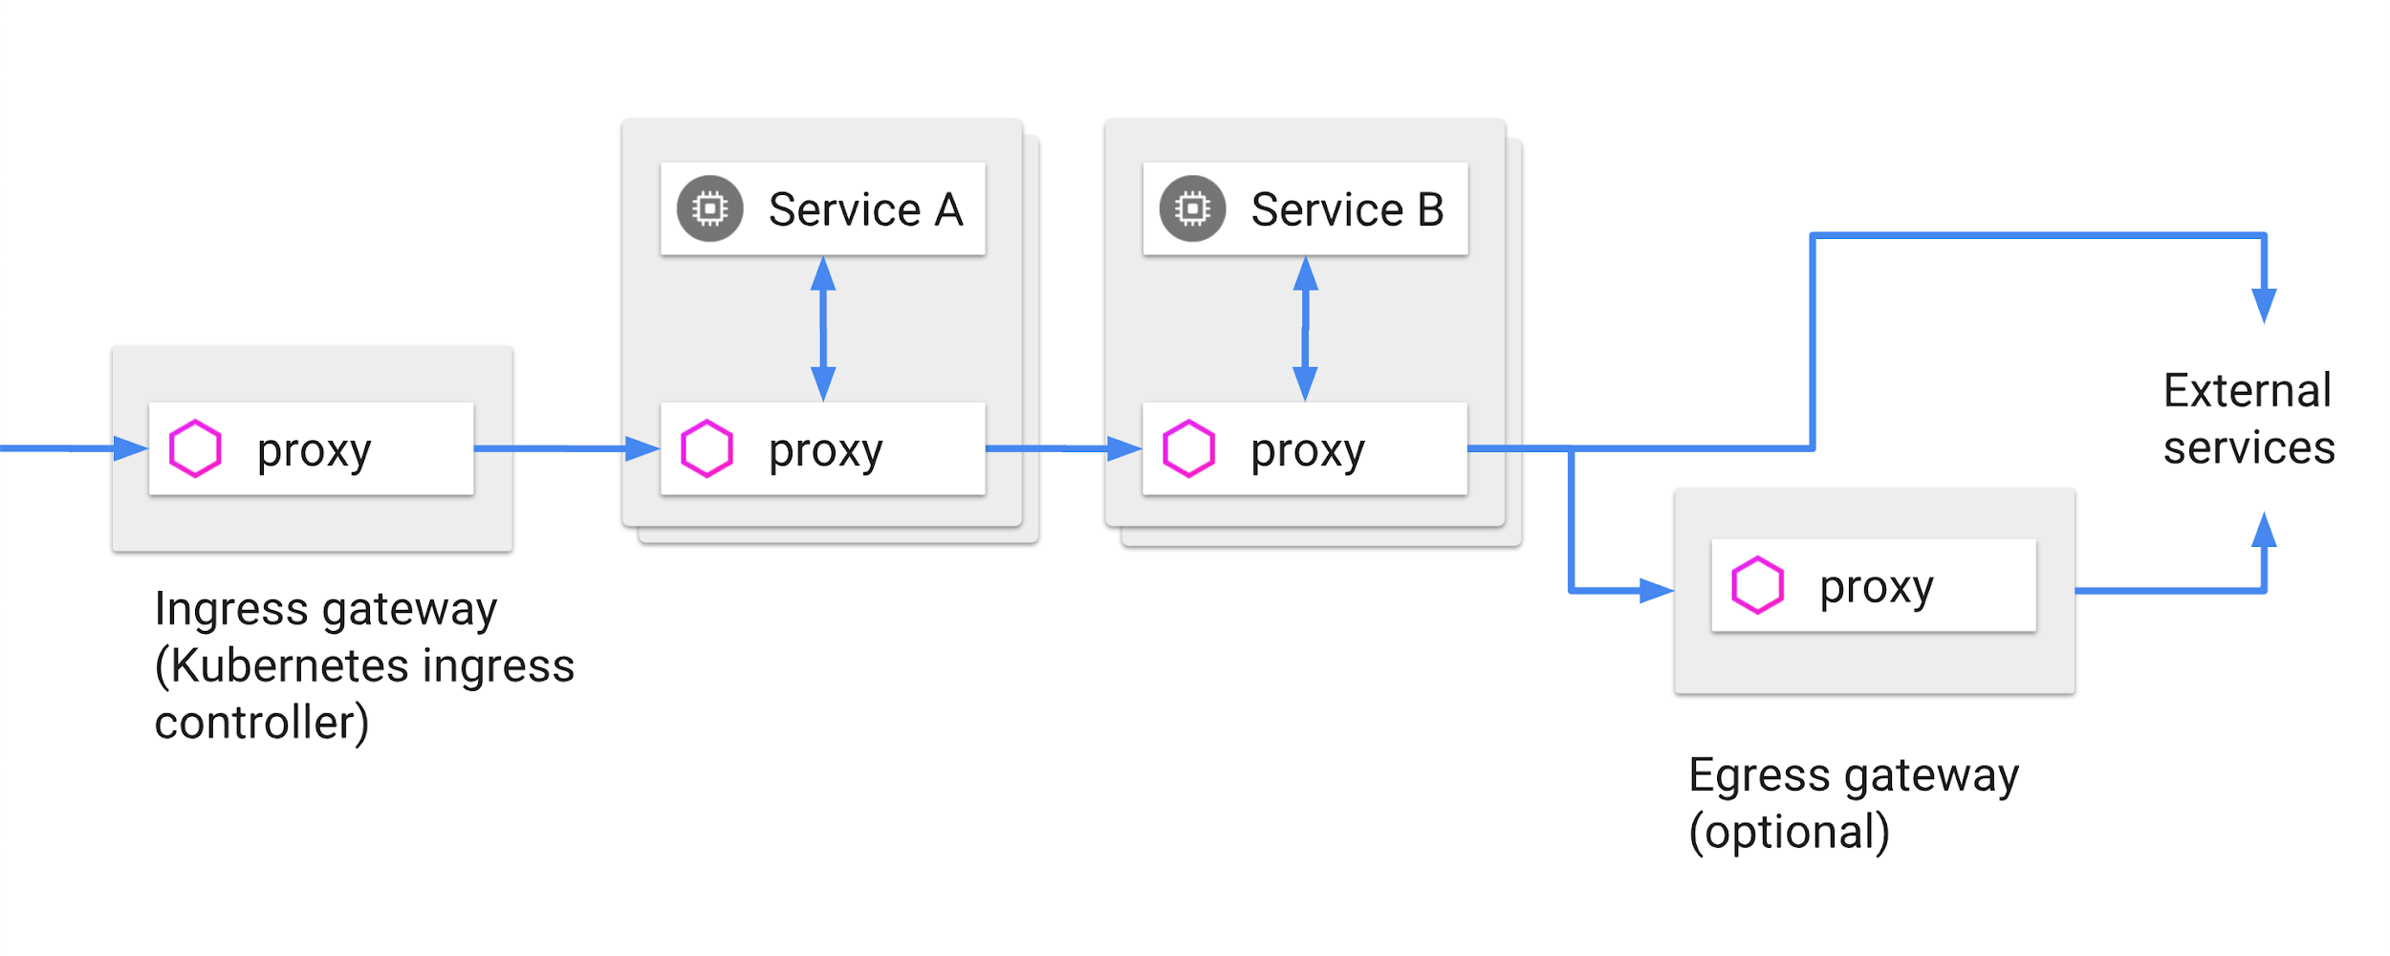
Implement...a suggested strategy
Our hardest part would be our migration to using Service Mesh tools for authz/authn
Create VirtualServices for any service that would receive traffic from the Istio Ingress Gateway
2) Create VS’s
1) Inject the Sidecar

Slide 21
Implement...a suggested strategy
Whitelist all outbound HTTPS/TCP traffic to 3rd party vendors (RDS, Credit Report Vendors, Redis...)
VPC Endpoints too! (Amazon CNI)
VPC Endpoints
RDS
3) Whitelist ServiceEntries and VirtualServices

Slide 22
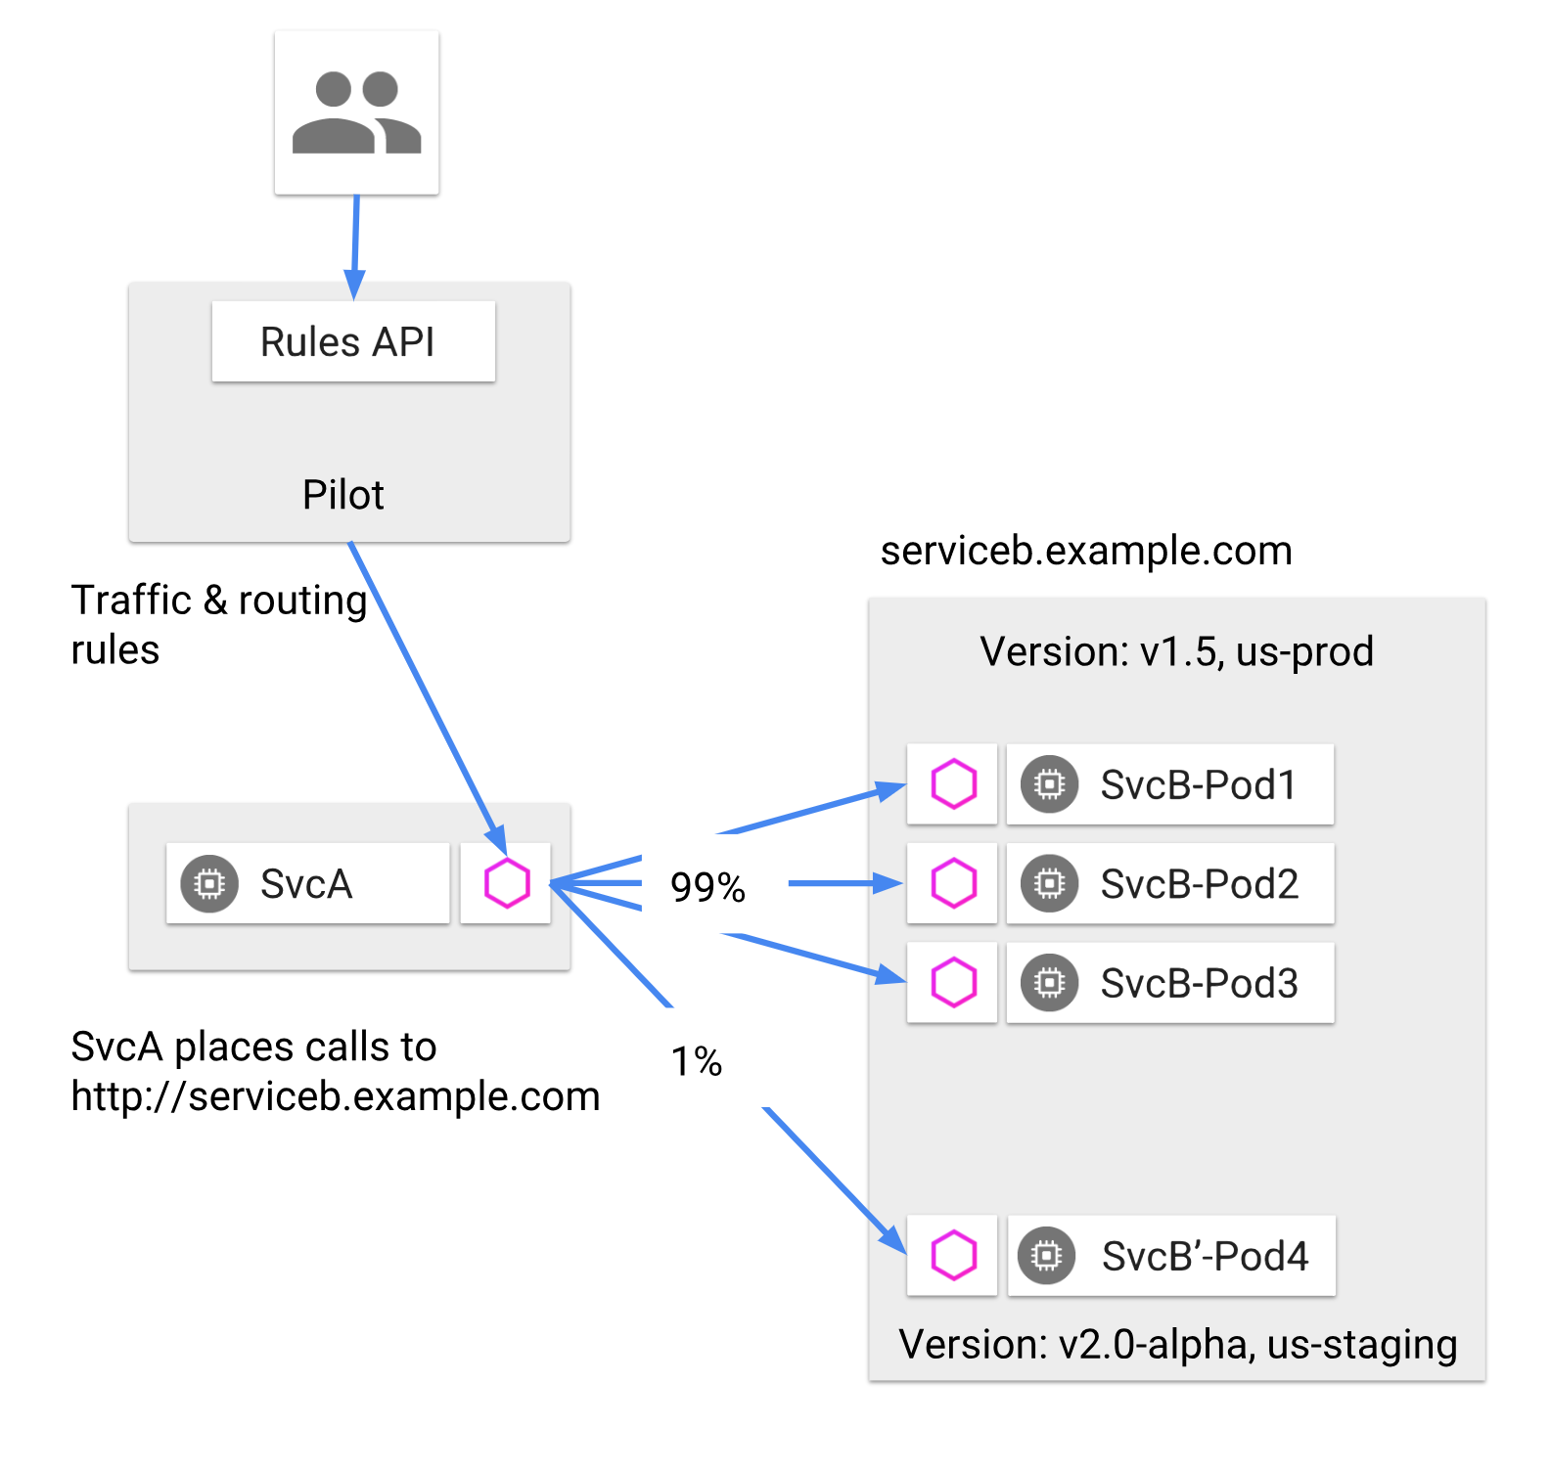
Implement...a suggested strategy
Get ready for deployments, and leverage Istio DestinationRules or Kubernetes Services
(if you do Blue/Green or Canary deployments)
Otherwise Istio just works like Kubernetes services
Load test, load test, load test

Slide 23
Release...with no interruptions
Provision SSL certs for public domains that you want routable in the mesh early
We used the Jetstack Certmanager (Open Source)
Change DNS to the ingress

Slide 24
Release...with no interruptions
Change the internal mesh policy to accept mixed auth traffic and change senders of traffic to use TLS
Enforce TLS everywhere by policy

Slide 25
Release...with no interruptions
Enforce communication restrictions via RBAC (if necessary)

Slide 26


